Slide 1
Leishmania Drug Resistance Genomics Session - 2
Kathryn Crouch
Mani Mudaliar
Jon Wilkes

Slide 2
What is
Genetic Variation?
Notes:
Let us start the session with a question.

Slide 3
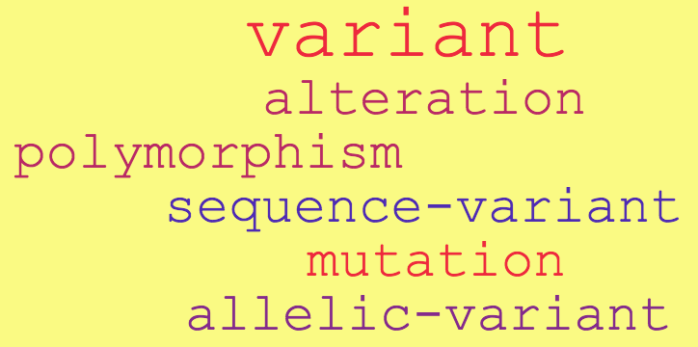
Genetic Variation
"a change / changes in the genomic sequence compared with the reference genomic sequence”
E.g., Substitution, Indel, Copy number variation, Translocation, Polyploidy or Aneuploidy
Notes:
Genetic variation can be divided into different forms according to the size and type of genomic variation underpinning genetic change. These include:
Small-scale sequence variation (< 1Kbp):[8]
Substitution
Indels
Large-scale Structural variation (>1Kbp):[8]
Copy number variation:
Copy number loss
Copy number gain
Rearrangement:
Translocation
Inversion
Segmental acquired uniparental disomy
Numerical variation (whole chromosomes or genomes):
Polyploidy
Aneuploidy

Slide 4
“Variation” or “Polymorphism” –
Nomenclature for the description of sequence variants
Polymorphism
A change found at a frequency of 1% or higher in the population
Generally a non disease-causing change
Single Nucleotide Polymorphism (SNP) and Copy Number Polymorphism (CNP)
Pathogenic variant, affects function, variants of unknown significance (VUS)
Follow on tasks:
1. Types of Genome Sequence Variants
2. General recommendations of the HGVS
http://www.hgvs.org/mutnomen/recs.html

Slide 5
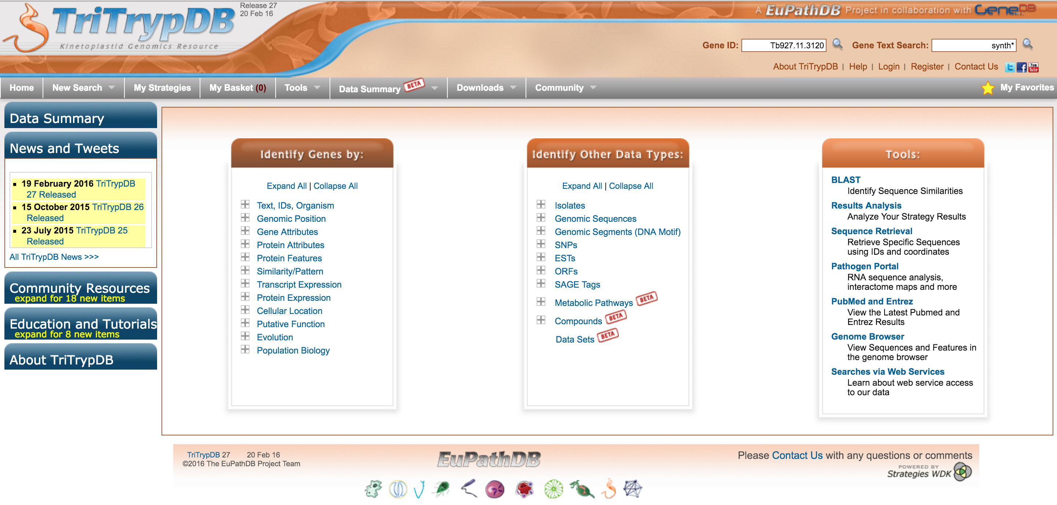
More info on genomics of Leishmania
Visit http://tritrypdb.org/tritrypdb/
Notes:
Resource for Leishmania genomics
Explore the wealth of information available at TriTrypDB

Slide 6
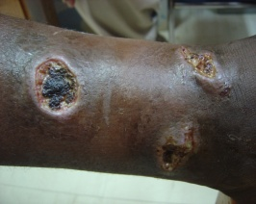

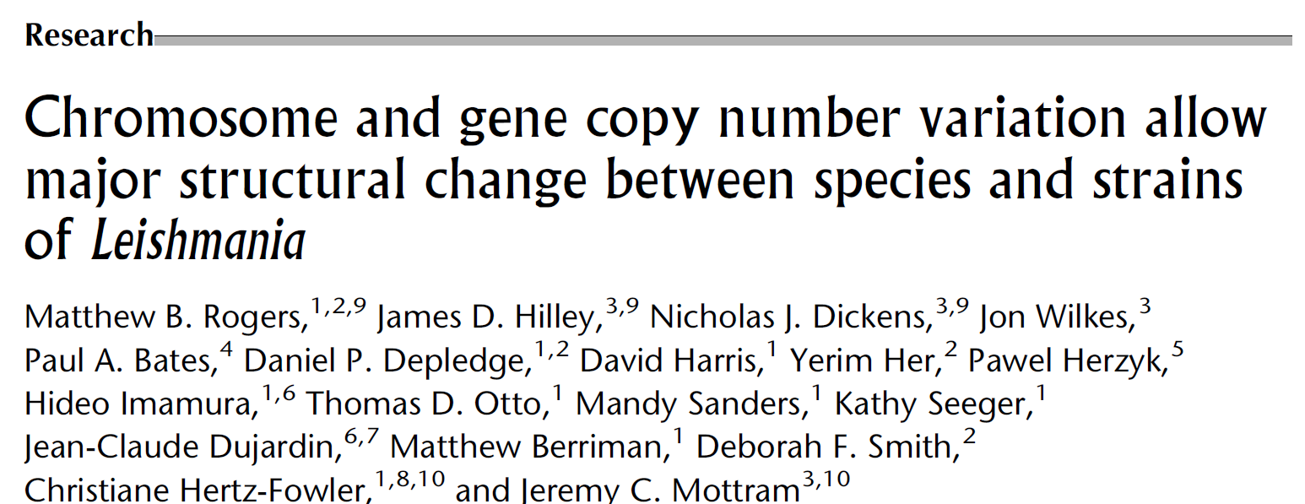
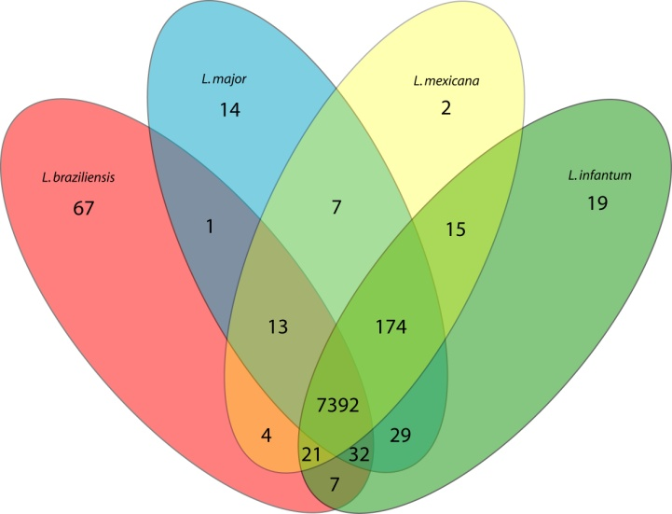
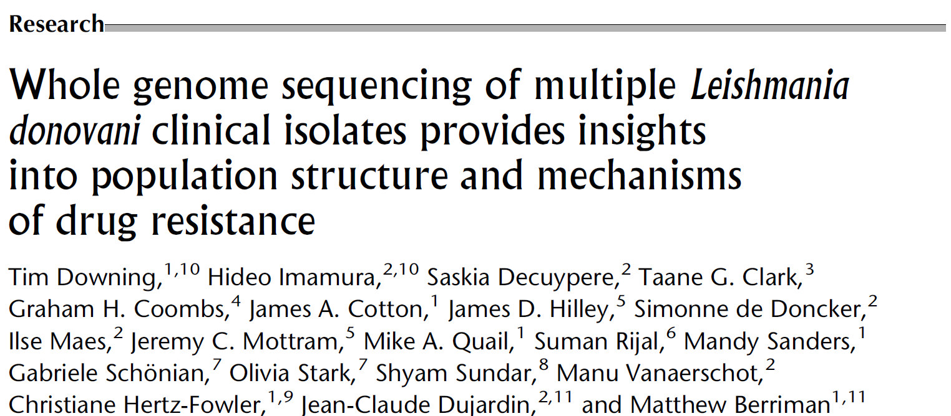
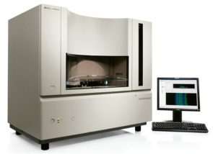
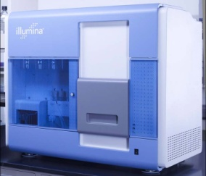
Comparative genomics: 4+1 Leishmania species
2011
Old World
New World
New World
Old World
+ L. donovani
But 27 genomes
Unique genes
Notes:
Importance of genomics profiling of parasites
How geographical distribution of different strains compare in genomics profiling

Slide 7
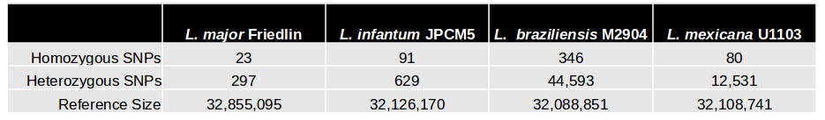
Sequence Diversity
Few unique Genes, few sequence variations
Figure Rogers, Hilley, Dickens et al. 2011

Slide 8
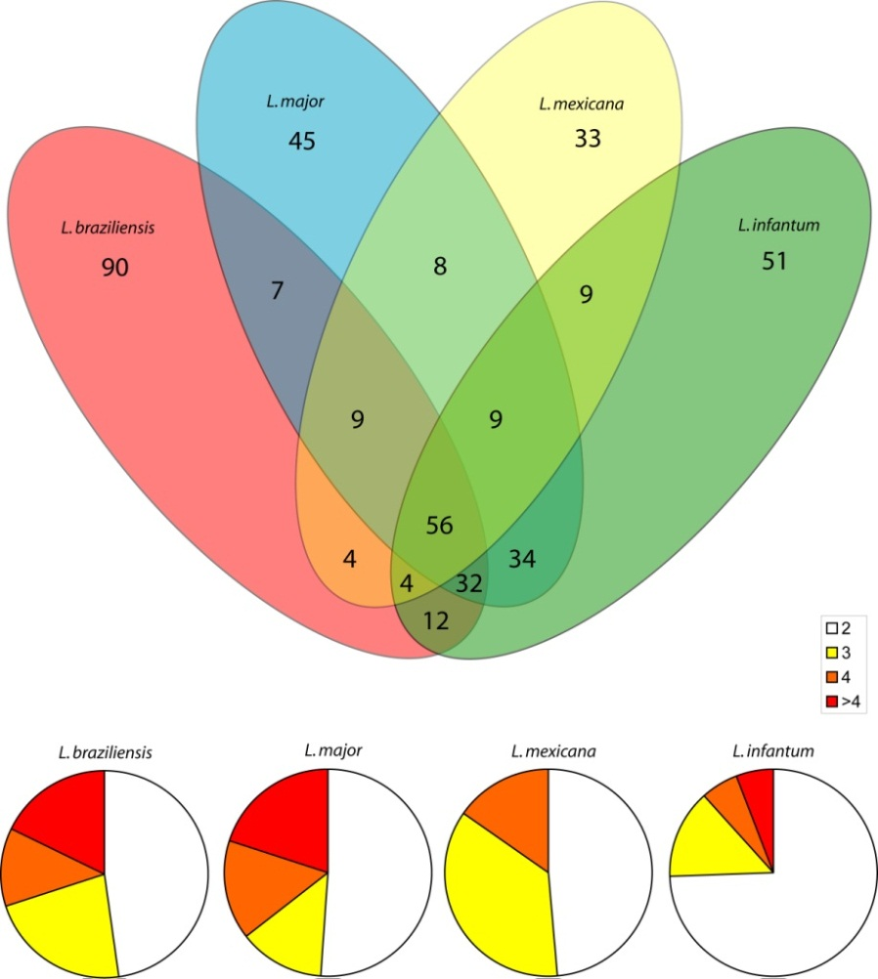
Comparative genomics: genome variation
Gene copy number variation

Slide 9
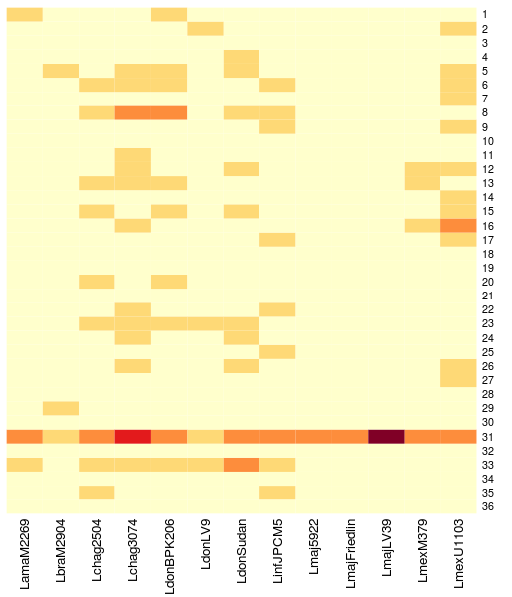
Chromosome copy number variation
L. braz
L. donovani
L. maj
L. mex
Chromosome
2 copies
3
4
5
6 copies

Slide 10
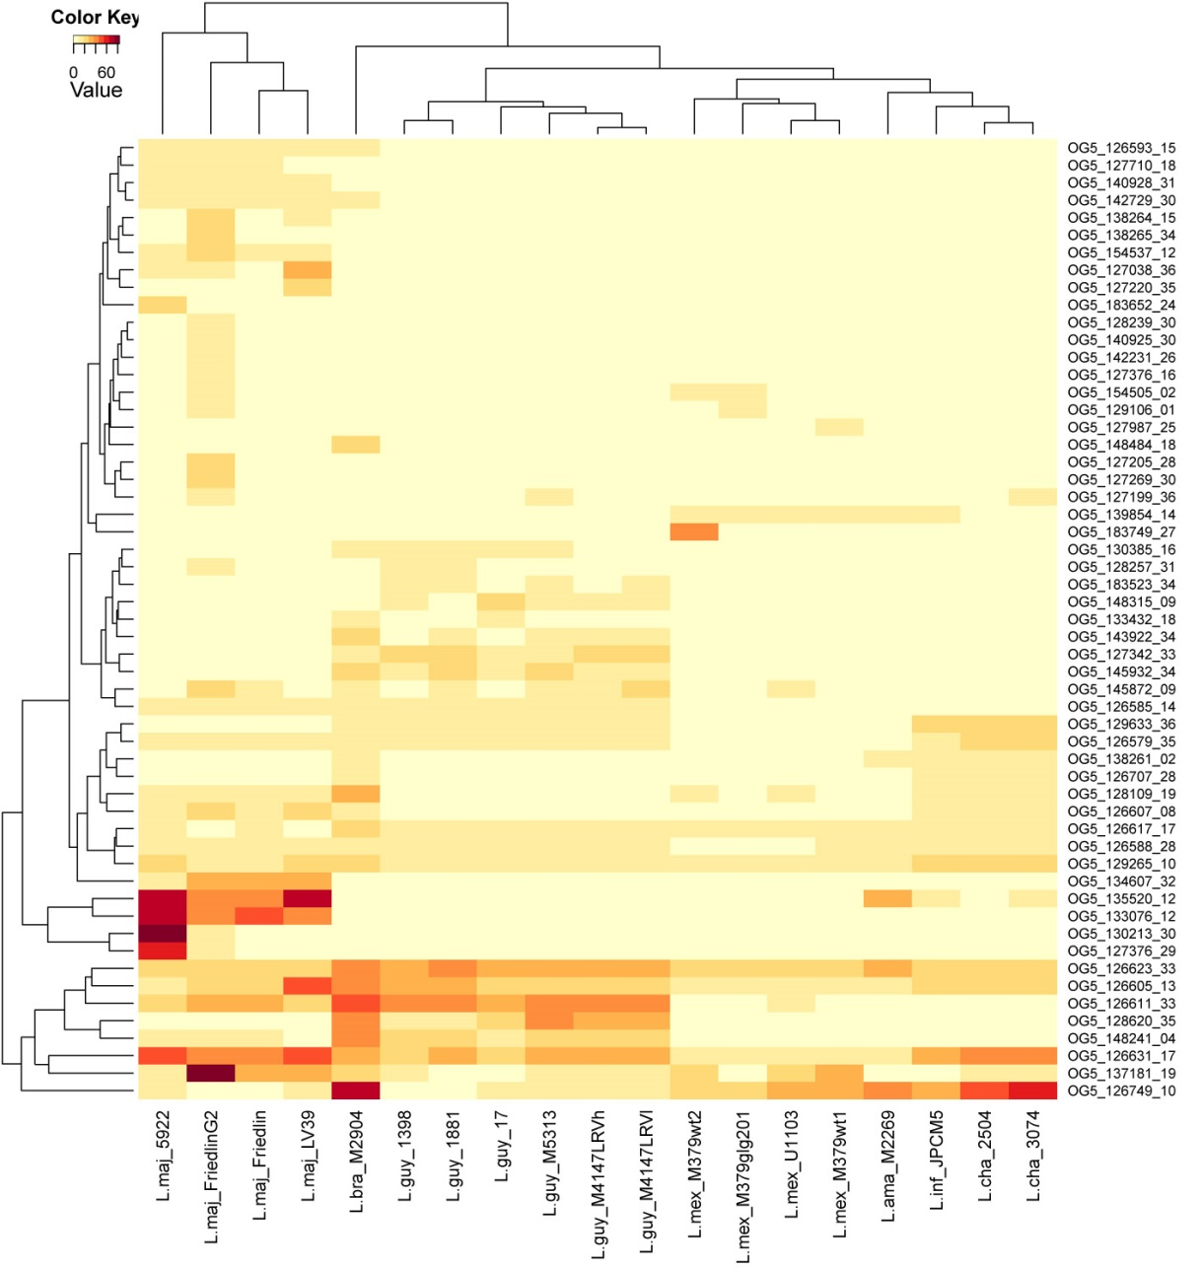
Gene Dose
disomic chromosome
disomic chromosome
trisomic chromosome

Slide 11
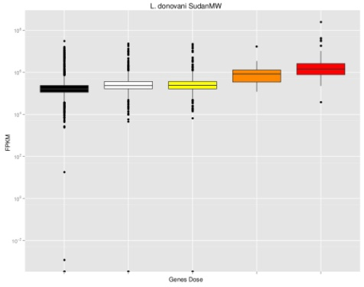
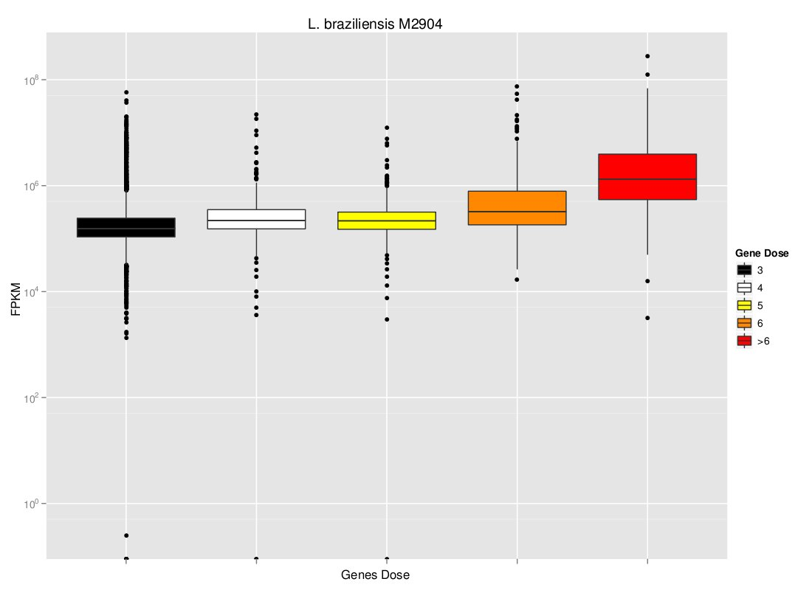
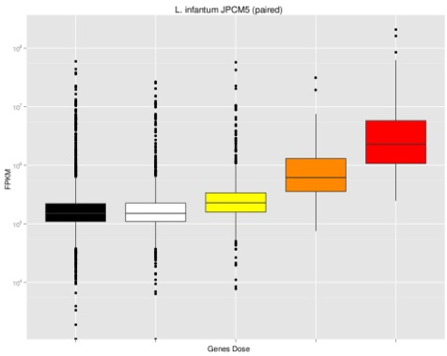
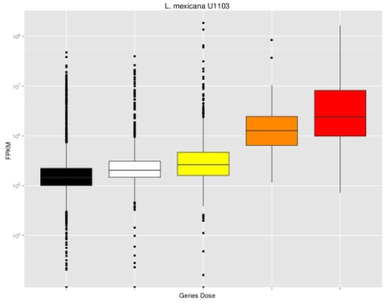
Is there a direct correlation between chromosome and gene CNV and mRNA levels?

Slide 12
Genomics Workflow
Obtain Read Data
Align Reads to Genome
Quality Control Alignment
Call Variants
Annotate Variants
Filter Variants
Quality Control Reads
Identify Changes
Session 1
Session 2
Session 3
Session 4

Slide 13
Session 2
Sort bam files and remove PCR duplicates (continue from the last session)
Exploration of mapped reads (BAM files)
Mapping Statistics
Variant calling using GATK

Slide 14
Software
IGV – for browsing the alignments
GATK – http://www.broadinstitute.org/software/igv/log-in
Bedtools – for generating stats and manipulating files
https://code.google.com/p/bedtools/
Reference Genome
To view genes you need the GFF file for L. mexicana U1103
http://tritrypdb.org/tritrypdb/

Slide 15
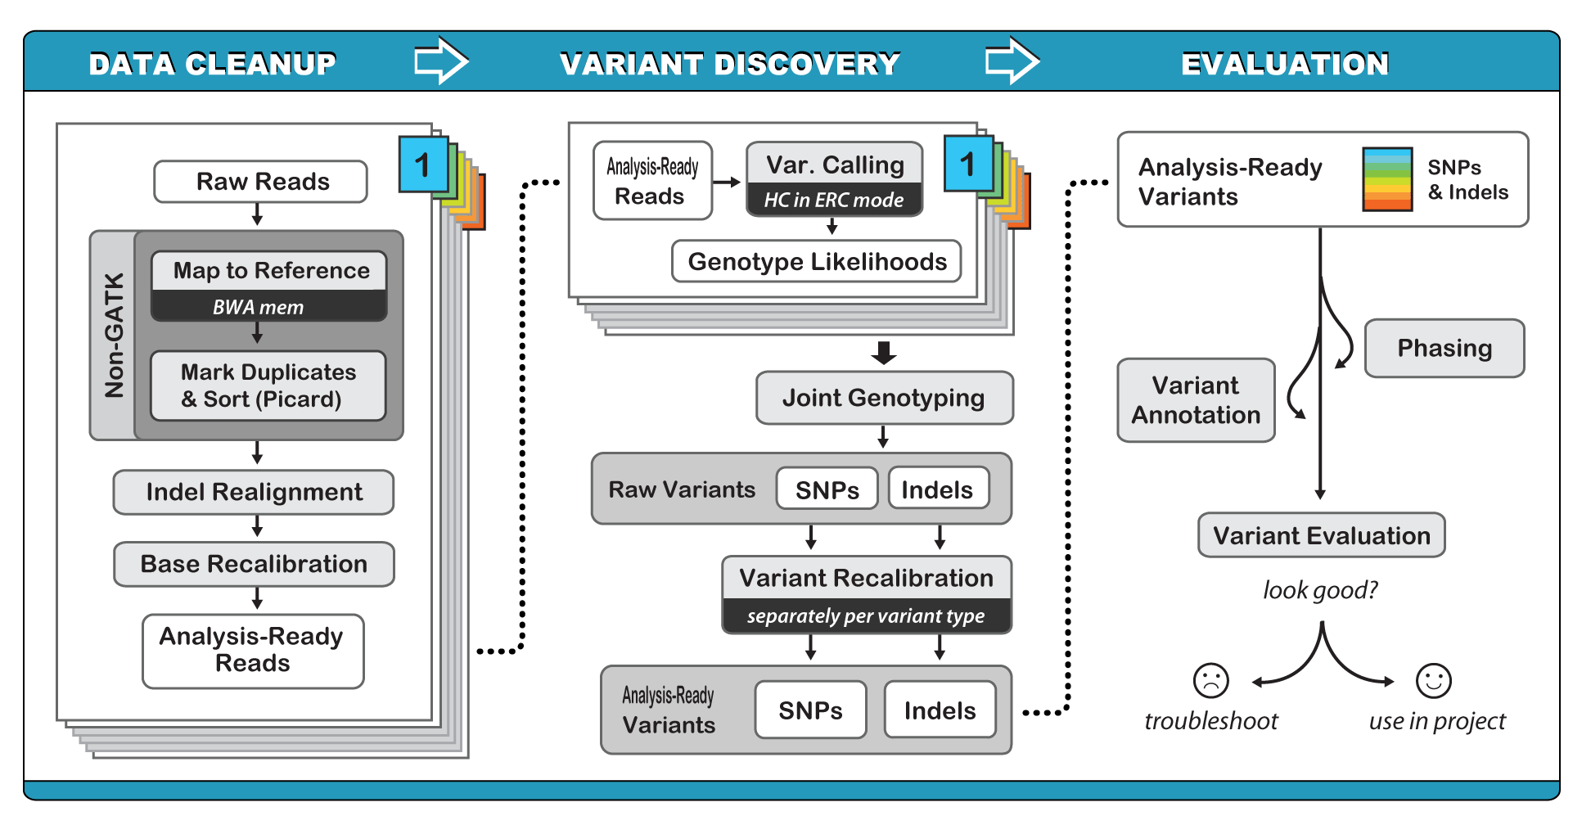
GATK Variant Calling Best Practices Workflow
www.broadinstitute.org/gatk/

Slide 16
Session 2 Objectives
By the end of this session you will be able to:
Sort bam files and remove PCR duplicates
Browse aligned read (bam) files
Use samtools to get chromosome size
Calculate read coverage by chromosome
Identify variants in the genome (SNPs)

Slide 17
Leishmania Drug Resistance Genomics Session 2
Generate a fasta index of the reference genome
Calculate per-chromosome coverage
Download L. mexicana U1103 gff for the reference genome from TriTrypDB
Browse aligned reads and specific genes
Generate SNPs for the genome using GATK
Save this output as a vcf file

Slide 18
Follow on task
Some of the chromosomes in the L. mexicana samples have more than 2 copies. Generate separate lists of SNPs for these chromosomes using the ploidy and –L options in GATK. Does this alter SNP calling for those chromosomes?

Slide 19
What are the different file formats used in genomics you have experienced with?

Slide 20
File formats and conventions - FASTA
First used by Bill Pearson
A single-line description (defline), followed by lines of sequence data
The defline has a greater-than (">") symbol at the beginning
Traditionally the sequence lines are limited to a width of 60 characters
>MT:647-1601
AATAGGTTTGGTCCTAGCCTTTCTATTAGCTCTTAGTAAGATTACACATGCAAGCATCCC
CGTTCCAGTGAGTTCACCCTCTAAATCACCACGATCAAAAGGAACAAGCATCAAGCACGC
AGCAATGCAGCTCAAAACGCTTAGCCTAGCCACACCCCCACGGGAAACAGCAGTGATTAA
CCTTTAGCAATAAACGAAAGTTTAACTAAGCTATACTAACCCCAGGGTTGGTCAATTTCG

Slide 21
File formats and conventions - FASTQ
FASTQ files have sequence and quality data (PHRED quality score), and the quality values are single-byte encoded.
Reference: DOI: 10.1093/nar/gkp1137
@NS500205:27:H15V6BGXX:1:11101:11986:1033 1:N:0:8
GCCCTNAGCGACCTGCACGCGCACAAGCTTCGGGTNGACCCGGTCAACTTCAAGCTCCTAAGCCACNGCCTGC
+
AAAAA#AFFF<FFFFFFFFFFFFFF<FFFFFFFFF#F<FFFFFFFF<FFFAFFFFFFFFFFFFFAF#FFFFFF
@NS500205:27:H15V6BGXX:1:11101:8152:1033 1:N:0:8
GCAAANCTGAAACTTAAAGGAATTGACGGAAGGGCNCCACCAGGAGAGGAGACTGCGGCTTAAAAANACACA
+
)A<A<#)FF<AFFFF<<.FAFAFF))FA<A)F..<#)F.A)FFF<F<..F..F.AF.)F.FFF.FA#)7)F.

Slide 22
File formats and conventions - GFF / GTF
Generic Feature Format (GFF) / Gene Transfer Format (GTF)
GFF2 = GTF
One line per feature, each containing 9 tab-separated columns of data, plus optional track definition lines
ID, Source, Feature type name, Start, End, Score, Strand, Frame, Attribute and track definition
http://www.ensembl.org/info/website/upload/gff.html
http://www.sequenceontology.org/gff3.shtml

Slide 23
File formats and conventions - SAM / BAM
SAM stands for Sequence Alignment/Map format
https://samtools.github.io/hts-specs/SAMv1.pdf
TAB-delimited text format with a header section, and an alignment section
The header lines begin with the character ‘@’
The alignment lines have 11 mandatory fields and optional aligner specific fields
BAM Format – 64Kb BGZF block compression on top of the standard gzip format

Slide 24
File formats and conventions - VCF
Variant Call Format (VCF)
http://www.1000genomes.org/wiki/Analysis/vcf4.0
VCF contains meta-information lines, a header line, and data lines.
Meta-information begins with ## string, often as key=value pairs
The data lines each containing information about a position in the genome

Slide 25
File formats and conventions - VCF
8 mandatory columns:
#CHROM
POS
ID
REF
ALT
QUAL
FILTER
INFO
FORMAT (parameters) and values for each Sample
e.g. GT:GQ:DP:RO:QR:AO:QA:GL 1/1:17.0545:1:0:0:1:40:-4,-0.30103,0

Slide 26
Code Snippets
# Sam to Bam
samtools view –bhS input.sam > output.bam
# Index using samtools
samtools index input.bam input.bai
# PICARD – BuildBamIndex
java –jar picard.jar BuildBamIndex I=input.bam

Slide 27
# Picard - create .dict file from fasta file
java –Xmx3g –jar picard.jar CreateSequenceDictionary R=Genome.fasta O=Genome.dict
# Samtools - create .fai file (fasta index file)
samtools faidx Genome.fasta

Slide 28
#Sort bam files using Picard ReorderSam
java –Xmx3g –jar picard.jar ReorderSam INPUT=sample1.bam OUTPUT=reordered_sample1.bam REFERENCE=Genome/Lmexicana.fa VALIDATION_STRINGENCY=LENIENT
#Sort bam files using Picard SortSam
java –Xmx3g –jar picard.jar SortSam INPUT=reordered_sample1.bam OUTPUT=sorted_reordered_sample1.bam SORT_ORDER=coordinate VALIDATION_STRINGENCY=STRICT

Slide 29
Remove PCR duplicates
java –Xmx3g –jar picard.jar MarkDuplicates INPUT=sorted_reordered_sample1.bam OUTPUT=markDup_sorted_reordered_sample1.bam METRICS_FILE=dup_met_sample1.txt REMOVE_DUPLICATES=false ASSUME_SORTED=true OPTICAL_DUPLICATE_PIXEL_DISTANCE=10 VALIDATION_STRINGENCY=LENIENT

Slide 30
#PICARD – Add Or Replace Read Groups
java –Xmx3g –jar picard.jar AddOrReplaceReadGroups I=markDup_sorted_reordered_sample1.bam O=rg_markDup_sorted_reordered_sample1.bam ID=1 LB=rgLib PL=illumina PU=single SM=WT (or SM=AmpB)

Slide 31
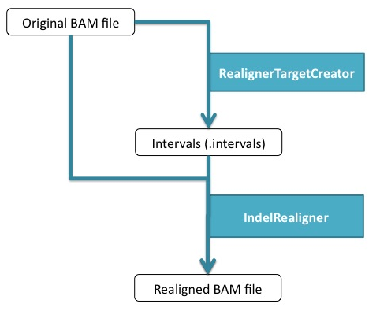
GATK - Local Realignment Around Indels

Slide 32
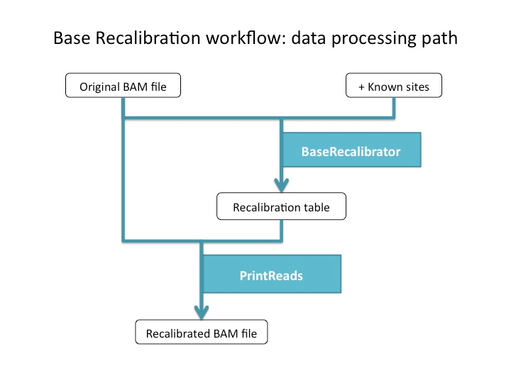
GATK - Base Quality Score Recalibration (BQSR)

Slide 33
GATK - Variant Discovery
java –Xmx3g –jar GenomeAnalysisTK.jar -T UnifiedGenotyper –R Genome.fasta -I rg_rmdup_WT_sorted.bam -o WT.snps.raw.vcf -stand_call_conf 30.0 -stand_emit_conf 10.0 -out_mode EMIT_VARIANTS_ONLY -l INFO -A Coverage -A HaplotypeScore -A InbreedingCoeff -glm SNP –nt 4

Slide 34
GATK - Variant Discovery
java –Xmx3g –jar GenomeAnalysisTK.jar -T UnifiedGenotyper –R Genome.fasta -I rg_rmdup_WT_sorted.bam -o WT.indel.raw.vcf -stand_call_conf 30.0 -stand_emit_conf 10.0 -out_mode EMIT_VARIANTS_ONLY -l INFO -A Coverage -A HaplotypeScore -A InbreedingCoeff -glm INDEL –nt 4

Slide 35
Browse aligned read (bam) files
Use IGV

Slide 36
Use samtools to get chromosome size
samtools faidx <ref.fasta>
### ref.fa.fai
1. Chromosome name
2. Chromosome length
3. Offset of the first base of the chromosome sequence in the file
4. Length of the fasta lines
5. Length of the fasta +1

Slide 37
Calculate read coverage by chromosome
bamtools split –in input.bam –reference *.fa
java –Xmx3g –jar picard.jar CollectWgsMetrics INPUT=sample1_chr1.bam OUTPUT=sample1_chr1_coverage.txt REFERENCE=Genome/Lmexicana.fa COVERAGE_CAP=100000 INCLUDE_BQ_HISTOGRAM=true VALIDATION_STRINGENCY=LENIENT
## Using Bedtools
genomeCoverageBed -ibam sortedBamFile.bam -g genome.txt > coverage.txt

